Slide 1
BUS7C1 CORPORATE STRATEGY AND INTERNATIONAL MANAGEMENT
Lecture 10
Lecturer: Kayleigh Cottam

Slide 2

By the end of today you will be able to…
Assess how performance can be measured using different techniques.
Identify the need for new strategies using gap analysis.
Employ SAFE (Suitability, Acceptability, Feasibility and Evaluation) to identify optimal strategic options.
Use a range of different techniques for evaluating options on financial and non-financial grounds.

Slide 3
Today’s lecture
Over the last 9 weeks you have addressed lots of different aspects of strategy in a global context including organisational vision and mission, strategy development, competitive advantage and innovation.
In this lecture we are going to look at how we evaluate strategy. When we evaluate something, we assess it. Is it effective, is it working, is there anything that we could improve?

Slide 4
What is strategy evaluation?
Strategy evaluation is the process by which organisational management will assess how well a chosen strategy has been implemented, how successful (or unsuccessful) it is and how it could be improved.
An organisation will review and appraise the strategy, the implementation process and the resulting performance.

Slide 5
How are strategy and performance linked?
A successful strategy will allow an organisation to achieve their vision, goals and create and maintain a competitive advantage.
We judge the impact/ effectiveness of the strategy by assessing organisational performance.
We address how well an organisation has performed in relation to its goals, whatever these may be (not necessarily profit).
Reviewing performance allows organisations to reflect on success and failure, and facilitates the re-examination of goals.
It is important as the goals themselves may have been set at a different time, under different circumstances (think about concepts such as financial crises, COVID etc.

Slide 6
Different types of performance measures
There are many techniques for measuring organisational performance. Different businesses prefer different measures.
However they broadly fall into two categories of economic and effectiveness measures, economic measures are more widely used, but they should not be the only considerations in a holistic approach i.e. Triple bottom line
Economic measures suffer from limitations which the broader effectiveness measures attempt to address.

Slide 7
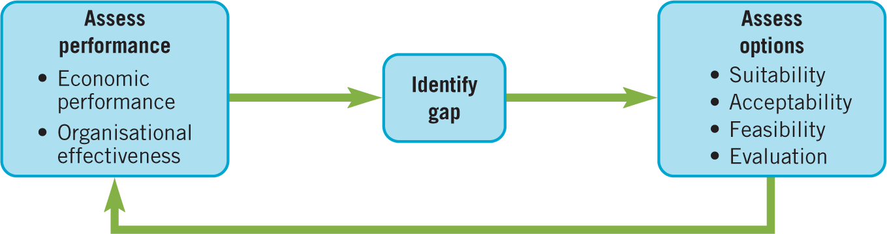
Evaluating strategies
In strategy evaluation, managers assess performance, then identify the extent of any gap between the desired and actual projected performance, then assess the strategic options for filling that gap. The chosen options will ultimately feed back into the future performance.

Slide 8
Approaches to performance and strategy evaluation
To reiterate:
We can distinguish between two basic approaches to performance: direct economic performance and overall organisational effectiveness.
It is also important to acknowledge that performance should not just be about economic performance.

Slide 9
Economic performance
Economic performance refers to direct measures of success in terms of economic outcomes.
There are three main dimensions:
Performance in product markets (e.g. sales growth or market share).
Accounting measures of profitability (e.g. profit margin or return on capital employed).
Financial market measures (e.g. share price).
These measures may seem objective but need to be carefully interpreted i.e. Sales growth, for example, may be achieved by cutting prices, thereby reducing profit margins. In view of this, a more comprehensive assessment of economic performance is often required.

Slide 10
The Du Pont Model
The Du Pont model is a useful technique for acknowledging the drivers of company profitability
It dissects a company’s return on capital employed (ROCE) in order to work out the components that add value to it.
It is particularly powerful in tracking changes over time and in comparison with competitor ratios.
https://www.youtube.com/watch?v=ScHXMzQ4Aqo
https://www.youtube.com/watch?v=efud1_fP9YU

Slide 11
Financial analysis
There are no absolute standards as to what constitutes good or poor return – it differs between industries and countries and stakeholders.
Other problems include:
Uncertainty – strategy is less certain than investment appraisal for discrete projects.
Specificity – hard to identify specific revenues and costs in strategy (e.g. spillover effects, wars, etc..)
Assumptions – analysis is only as good as the assumptions it is based on.

Slide 12
Effectiveness (performance)
Effectiveness refers to a broader set of performance criteria reflecting internal operational efficiency or measures relevant to a wider range of stakeholders
A broad measure of effectiveness is provided by the balanced scorecard which considers four perspectives (i.e. the customer, internal business, innovation and learning and financial perspectives).
The triple bottom line – has economic, social and environmental measures (this is particularly relevant)

Slide 13
The balanced scorecard
The balanced scorecard considers four perspectives on performance simultaneously in order to prevent the dominance of a single perspective.
It considers
1) Financial perspective, which for a for-profit company typically means focusing upon increasing shareholder value. This can be achieved through revenue growth and productivity gains, such as cost reduction and efficiency gains.
2) Customer perspective, as this defines how a company differentiates itself from competitors in the market. This can be assessed using measures such as customer satisfaction or product quality.
3) Internal business perspective, focuses upon alignment between organisational processes and financial and customer perspectives. Productivity measures or project management measures are often used.

Slide 14
The balanced scorecard – continued
Financial perspective
Profit
Customer perspective
Differentiation
Innovation and learning perspective
Employee skills & training
Internal business perspective
Alignment between organisational processes and financial and customer perspectives.
Shareholder value
Revenue
Productivity gains
Customer satisfaction
Product quality
HR
Support
4) Innovation and learning perspective - assesses the employee capabilities and skills and corporate climate needed to support a strategy.
Typical measures include new product introductions or employee skills so that human resources and information technology align with the other perspectives.
The performance measures of each perspective can be cascaded down through the organisation to individual business units to allow overall alignment

Slide 15
TBL – Triple Bottom Line
Cannibals with forks - Elkington, J. (1998). Partnerships from cannibals with forks: The triple bottom line of 21st‐century business. Environmental quality management, 8(1), 37-51
Broad measure of performance - pays explicit attention to corporate social responsibility and the environment.
The 3p’s
3BL
Corporate social responsibility
People
Profit
Planet
SUSTAINABILITY

Slide 16
People, profit, planet
(Profit) - Economic measures of performance such as sales, profits and share price
(People) - social measures, such as employee training, health and safety and contributions to the local community
(Planet) - environmental measures such as pollution, recycling and wastage targets.

Slide 17
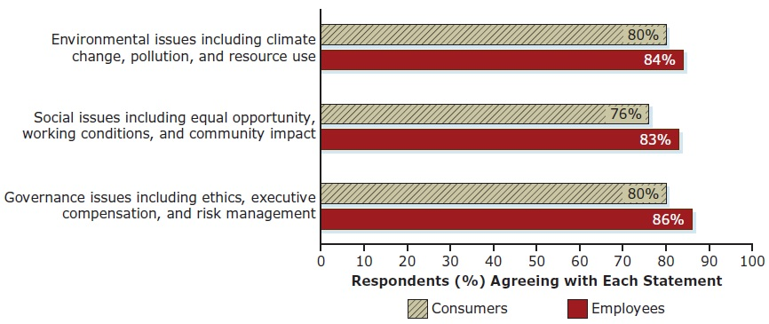
Where People Want to Shop and Work
Notes:
Figure shows that consumers and employees want companies to stand up for the environment, corporate social responsibility, and business governance.
In addition, fully 91 percent of business leaders believe their company has a responsibility to act on these issues.
The horizontal axis is labeled, respondents (%) agreeing with each statement and ranges from 0 to 100 in increments of 10. The vertical axis lists three different categories. The data is as follows.
Environmental issues including climate change, pollution, and resource use. Consumers, 80%. Employees, 84%.
Social issues including equal opportunity, working conditions, and community impact. Consumers, 76%. Employees, 83%.
Governance issues including ethics, executive compensation, and risk management. Consumers, 80%. Employees, 86%.

Slide 18
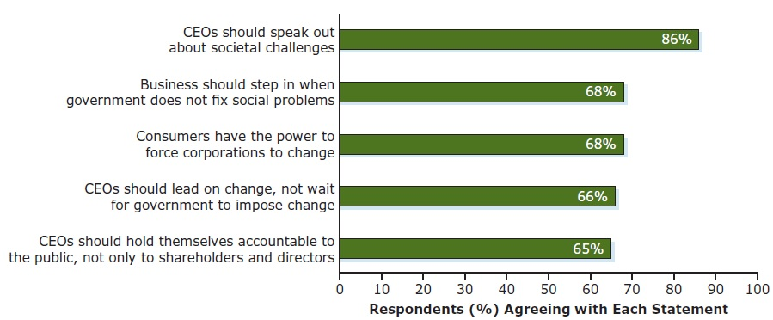
People Want Business to Lead on Social Change
Notes:
shows the results of a 28-nation survey by the Edelman Trust Barometer which found that consumers want businesses to take a greater stand on social issues.
The horizontal axis plots respondents, percentage agreeing with each statement ranges from 0 to 100 in increments of 10. The data are as follows. C E O's should speak out about societal challenges, 80%. Business should step in when government does not fix social problems, 68%. Consumers have the power to force corporations to change, 68%. C E O's should lead on change, not wait for government to impose change, 66%. C E O's should hold themselves accountable to the public, not only to shareholders and directors, 65%.

Slide 19

Example – Heineken
Most listed companies today publish sustainability reports and Dutch brewer Heineken is a good example
Heineken has a high ranking on the Dow Jones sustainability index and lists specific social metrics for employees (reducing accident frequency, training, employee volunteering)
Environmental metrics (water usage, CO2 emissions and energy consumption).
Both the balanced scorecard and the triple bottom line share a view that overall effectiveness depends not only on economic performance, but on a range of factors that support the long-term prosperity of the organisation.

Slide 20
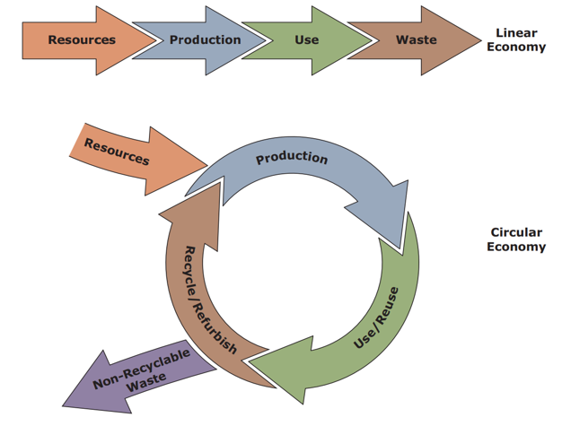
Linear versus Circular Economy
Notes:
As shown in Figure a circular economy differs greatly from a linear economy in that it designs waste and pollution out of production processes from the start.
The linear economy shows resources leading to production. Production leads to use which leads to waste. The circular economy shows a cyclic diagram with production leading to use or reuse which leads to recycle or refurbish. The recycle or refurbish leads back to production. Also, resource leads to production and non-recyclable waste leads away from recycle or refurbish.

Slide 21
Performance comparisons
Performance is measured in relation to:
Organisational targets. Management will typically set targets for sales growth or profitability.
Trends over time. Is performance improving or declining over a significant period of time (but be aware of cycles)?
Comparator organisations. Typically firms can benchmark themselves against key competitors (but beware of high risk rivals).

Slide 22
Gap analysis
Gap analysis compares achieved or projected performance with desired performance.
Helps to identify shortfalls in performance.
The size of the ‘gap’ provides a guide to the extent to which strategy needs to be changed – a very large gap may suggest transformational change is needed.

Slide 23
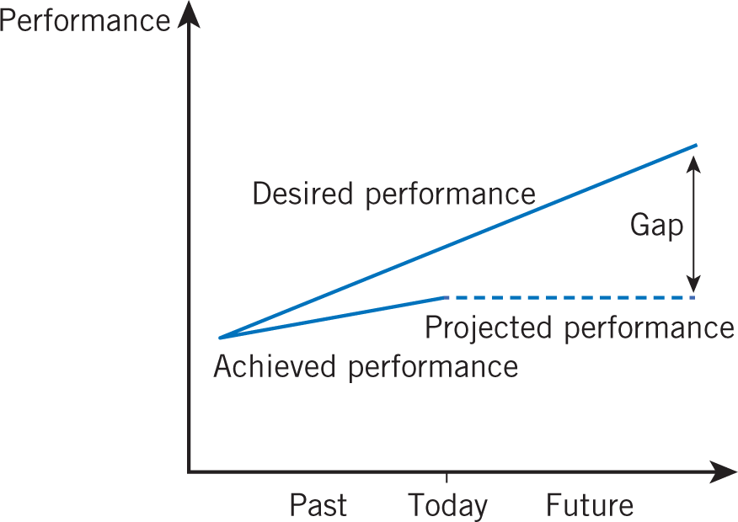
Gap analysis
Gap analysis compares actual or projected performance with desired performance.
It is useful for identifying performance shortfalls (‘gaps’) and, when involving projections, can help in anticipating future problems.
The size of the gap provides a guide to the extent to which strategy needs to be changed.
The upper line represents the organisation’s desired performance, perhaps a set of targets or the standard set by competitor organisations.

Slide 24
Gap analysis continued
The lower line represents both achieved performance and projected performance based on a continuation of the existing strategy into the future (this is necessarily an estimate).
There is already a gap between achieved and desired performance therefore performance is unsatisfactory. The gap is projected to become even bigger on the basis of the existing strategy.
Assuming ongoing commitment to the desired level of performance, the organisation needs to adjust its existing strategy in order to close the gap.

Slide 25
Complexities of performance analysis
Performance measures can be contradictory, for example, sales growth can be achieved by cutting profit margins.
Organisations can manipulate outcomes in order to meet key performance criteria.
Organisations can legitimately manage performance perceptions and expectations.
The importance of particular measures can change over time.

Slide 26
Evaluating new initiatives
If you have performed a gap analysis and the strategy is not meeting the desired outcomes, we need to assess and evaluate possible new initiatives to solve the strategy and performance issues.
One way of doing this is to use the SAFE criteria - suitability, acceptability, feasibility and evaluation (note there are several sections to each of these categories)

Slide 27
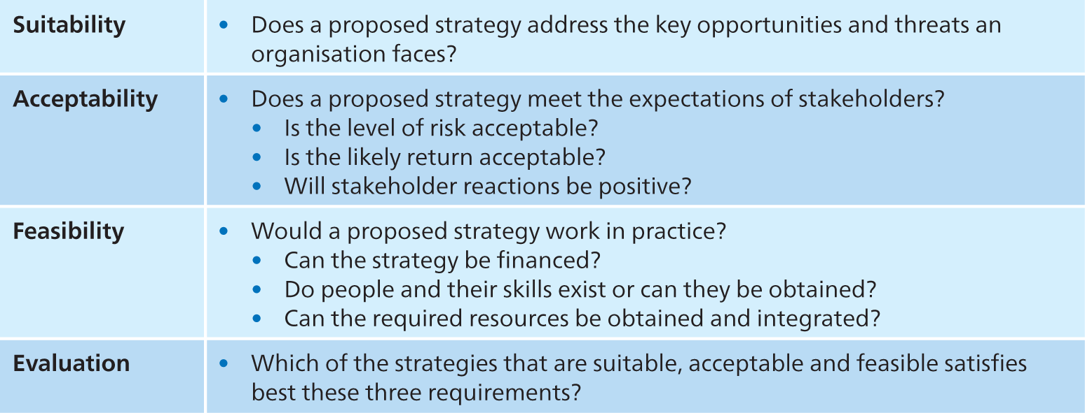
The SAFE criteria and key questions

Slide 28
SAFE - Strategy suitability
Suitability is concerned with assessing which proposed strategies address the key opportunities and threats an organisation faces.
It is concerned with the overall rationale of the strategy:
Does it exploit the opportunities in the environment and avoid the threats?
Does it capitalise on the organisation’s strengths and avoid or remedy the weaknesses?

Slide 29
Suitability - Ranking and screening techniques
There are several useful techniques:
Ranking
Screening through scenarios.
Screening for bases of competitive advantage – using the VRIO criteria.
Decision trees

Slide 30
Decision tree
Decision trees can be used to assess strategic options against a list of key factors.
In this assessment method options are ‘eliminated’ and preferred options emerge by progressively introducing requirements that must be met (such as growth, investment or diversity).
The end point of the decision tree is a number of development opportunities. The elimination process is achieved by identifying a few key elements or criteria that possible strategies need to achieve.
But the yes/no actions may at times neglect so highlight additional options that may be viable – not always as simple as answering yes or no.
https://www.youtube.com/watch?v=LG0uXzUc7MY

Slide 31
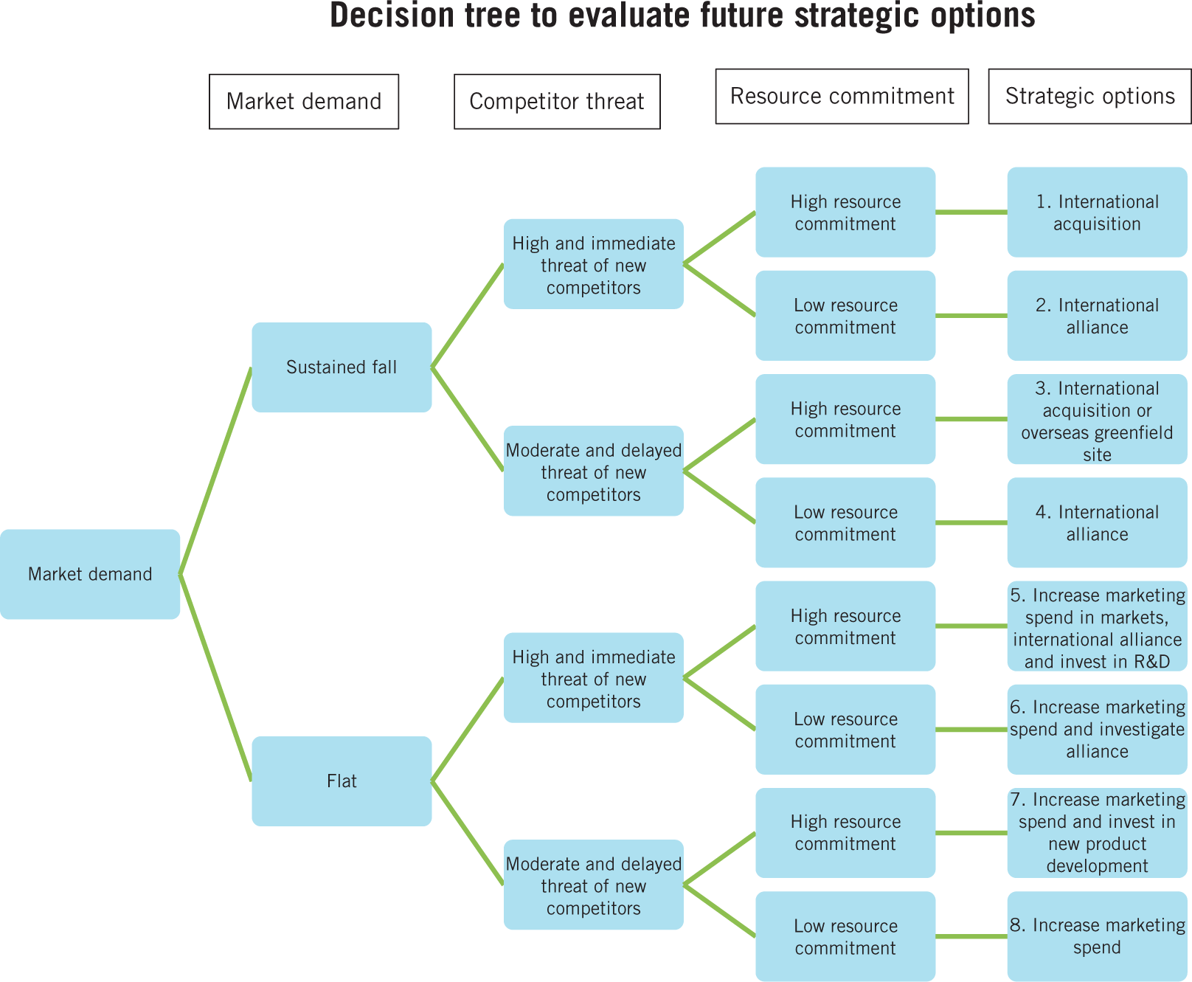
A strategic decision tree for a law firm

Slide 32
SAFE - Acceptability
Acceptability is concerned with whether the expected performance outcomes of a proposed strategy meet the expectations of stakeholders.
There are three important aspects to acceptability (the 3 ‘R’s)
Return
Risk
Stakeholder reactions

Slide 33
The three R’s - Return
These are a measure of the financial effectiveness of a strategy.
Different approaches to assessing return:
Financial analysis.
Shareholder value analysis
Cost–benefit analysis
Real options

Slide 34
Applying ‘returns’ to different sectors
It is sensible to use more than one approach in assessing the acceptability of a strategy.
Returns – are measures of the financial profitability and effectiveness of a strategy. In the private sector, investors and shareholders expect a financial return on their investment.
In the public sector, funders (typically government departments) are likely to measure returns in terms of the ‘value for money’ of services delivered.

Slide 35
Attention often focuses on financial metrics of efficiency but measuring return for not-for-profits is notoriously difficult as there is great diversity in the sector in terms of multiple, often conflicting, stakeholder interests.
However, three types of performance metric can be used that include success in mobilising resources, staff effectiveness and progress in fulfilling mission.
Measures of return are a common way of assessing proposed new ventures or major projects within businesses. An assessment of the financial effectiveness of any specific strategy should be a key criterion of acceptability.

Slide 36
The three R’s - Risk
Risk concerns the extent to which strategic outcomes are unpredictable, especially with regard to negative outcomes.
Risk can be assessed using:
Sensitivity analysis
Financial risk – use ratios, for example, gearing and liquidity.
Break-even analysis.
Notes:
https://www.youtube.com/watch?v=3offFagEWKg

Slide 37
Financial Risk
Financial risk refers to the possibility that the organisation may not be able to meet the key financial obligations necessary for survival. Strategies should meet acceptable levels of financial risk.
Two key criteria:
Gearing – the amount of debt the company has relative to its equity.
Liquidity – the amount of liquid assets (e.g. cash) that is available to pay its immediate bills.

Slide 38
Break-even analysis
A simple and widely used approach allowing variations in assumptions about key variables in a strategy to be examined.
It shows at what point in terms of revenue the business will recover its fixed and variable costs and thus break even.
It can be used to assess the risks associated with different price and cost structures of strategies.

Slide 39
The three R’s - Stakeholder reaction
Stakeholder mapping (power/attention matrix) can be used to:
Understand the political context of strategies.
Understand the political agenda.
Gauge the likely reaction of stakeholders to specific strategies.
If key stakeholders find a strategy to be unacceptable, then it is likely to fail.

Slide 40
SAFE - Feasibility
Feasibility is concerned with whether a strategy could work in practice, that is, whether an organisation has the capabilities to deliver a strategy.
Two key questions:
Do the resources and competences currently exist to implement the strategy effectively?
If not, can they be obtained?

Slide 41
Feasibility
Need to consider:
Financial feasibility – funding and cash flow.
People and skills – competences, knowledge and experience.
Integrating resources – obtaining and integrating new resources.

Slide 42
Looking closer - people & skills
When considering the people in an organisation we need to think about the following questions:
Do people in the organisation currently have the competences to deliver a proposed strategy?
Are the systems to support those people fit for the strategy?
If not, can the competences be obtained or developed?
Notes:
https://www.youtube.com/watch?v=PxtXI0K4YJs

Slide 43
Resource integration for success
The success of a strategy depends on the management of many resource areas, for example:
people
Finance
physical resources;
information
Technology
resources provided by suppliers and partners.
It is essential to integrate resources – inside the organisation and in the wider value system.

Slide 44
Critical issues for consideration
Critical issues that need to be considered:
Work organisation – will this need to change?
Rewards – are the incentives appropriate?
Relationships – will people interact differently?
Training and development – are current systems appropriate?
Recruitment and promotion – are the levels and skills of the staff appropriate?

Slide 45
SAFE - Evaluation
Evaluation is concerned with identifying strategies that can pass all the hurdles of suitability, feasibility and acceptability.
When evaluating is important to:
Be aware of conflicting conclusions and the need for management judgement.
Ensure consistency between the different elements of a strategy is essential.
Be aware that the implementation and development of strategies might reveal unanticipated problems.
Acknowledge that strategy development in practice isn’t always a logical or even rational process.

